Slide 1
Model-based functional Magnetic Resonance Imaging
Steven Miletić
Model-based Neuroscience Summer School
Amsterdam, 2024

Slide 2
Outline Today
Reciprocal relations
How can we use cognitive models to inform fMRI analyses?
Pt. 1: Lecture
Introduction to functional magnetic resonance imaging
Pt. 2: Tutorial/workshop/practical
Python for model-based fMRI analyses
Provide an overview of the possibilities, and an idea of where to start

Slide 3
Outline Lecture
Introduction to functional magnetic resonance imaging
What are we measuring?
How do we analyze the data?
Preprocessing
Traditional: Mass-univariate analyses
Model-based analyses
Python for neuroscience

Slide 4
Outline Lecture
Introduction to functional magnetic resonance imaging
What are we measuring?
How do we analyze the data?
Preprocessing
Traditional: Mass-univariate analyses
Model-based analyses
Python for neuroscience

Slide 5
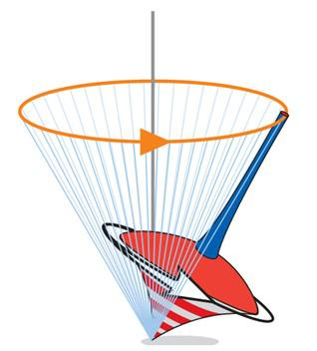
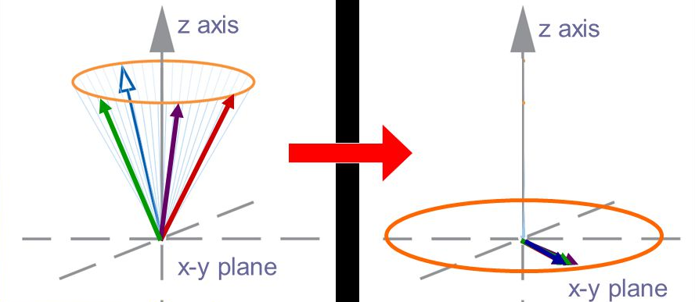
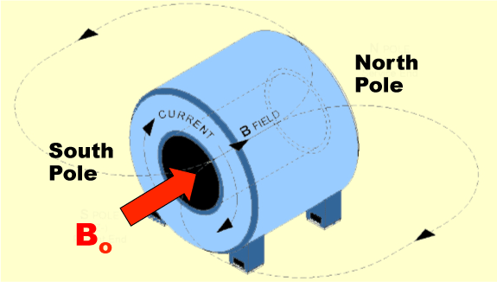
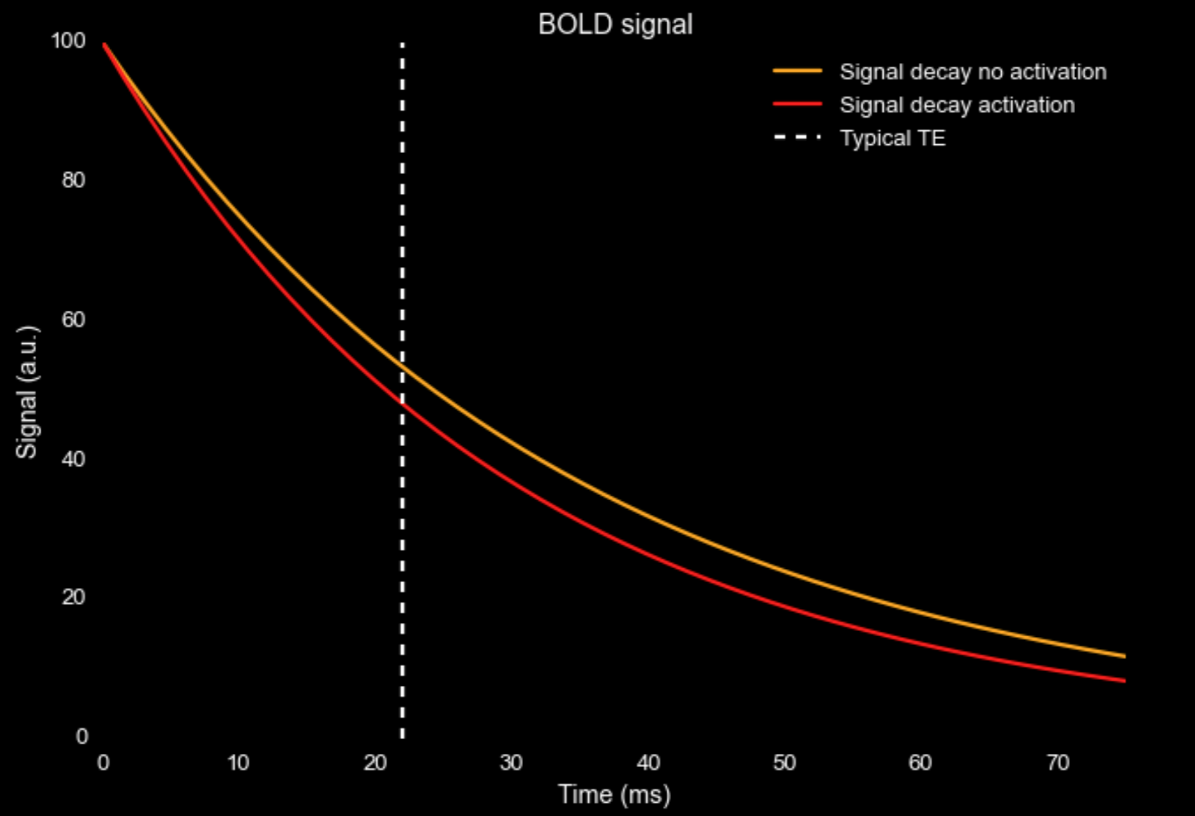
What are we measuring? (a very short summary)
Magnetic properties of the brain
Hydrogen atoms align with
strong magnetic field
Brought in high energy state by scanner
Release of energy is measured, and depends on:
- Tissue and surroundings
- Oxygenation

Slide 6
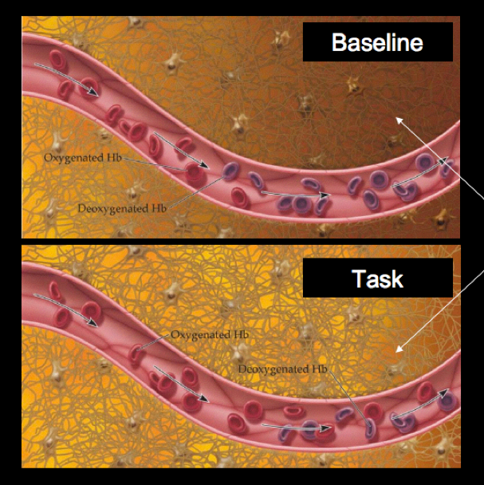
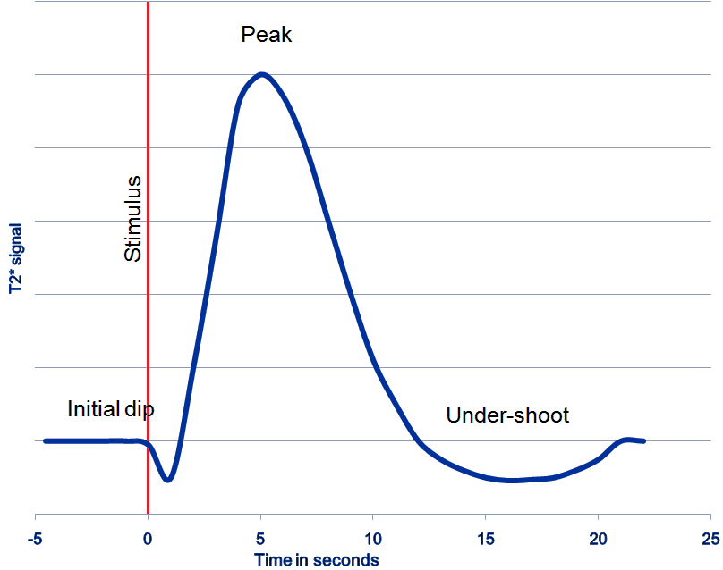
What are we measuring? (a very short summary)

Slide 7
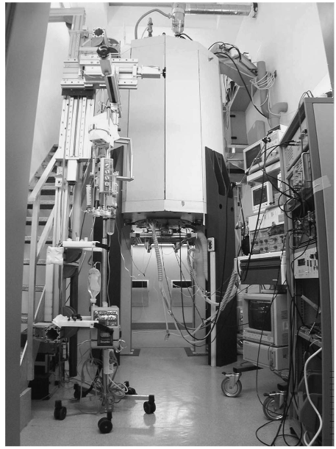
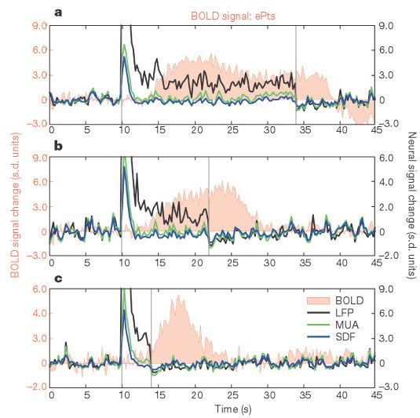
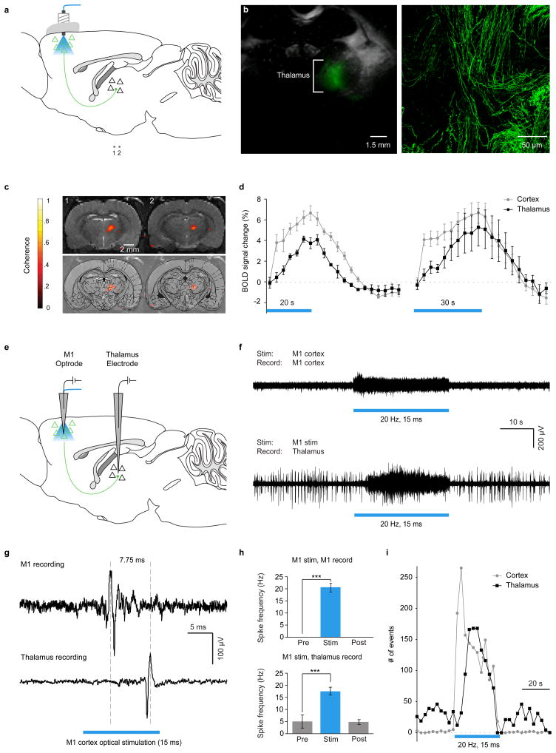
What are we measuring? (a very short summary)
Is BOLD really a proxy for neural activity?
Logothetis (2001): Intracortical recordings
Lee et al. (2010):
Optogenetics

Slide 8
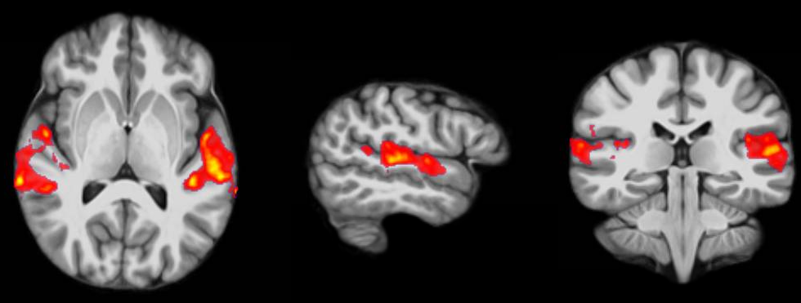
Outline Lecture
Introduction to functional magnetic resonance imaging
What are we measuring?
How do we analyze the data?
Preprocessing
Traditional: Mass-univariate analyses
Model-based analyses
Python for neuroscience

Slide 9
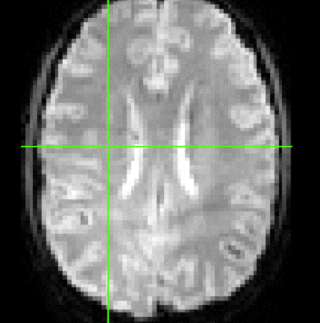
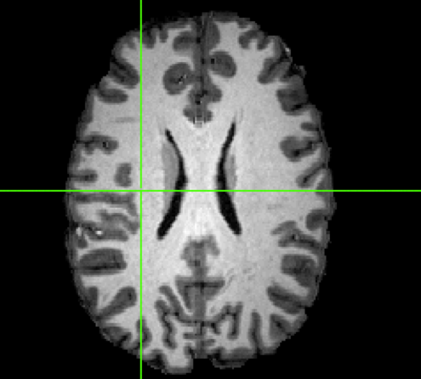
Data collection
Structural scan (~1mm isotropic)
Typical fMRI session
Localizer (2 min)
Structural scan (8-10 min)
Task (30-60 min)
Field map (5 min)
Functional scan (~3mm isotropic)
Every TR (~ 2 seconds)

Slide 10
Data analysis Preprocessing
6 steps:
Slice time correction
Motion correction
Co-registration
Normalization
Spatial smoothing
Temporal filtering

Slide 11
Data analysis Preprocessing
6 steps:
Slice time correction
Motion correction
Co-registration
Normalization
Spatial smoothing
Temporal filtering
}
Dealing with “imperfections” of the scanner:
Different parts of the data are acquired at different time points

Slide 12

Data analysis Preprocessing
6 steps:
Slice time correction
Motion correction
Co-registration
Normalization
Spatial smoothing
Temporal filtering

Slide 13
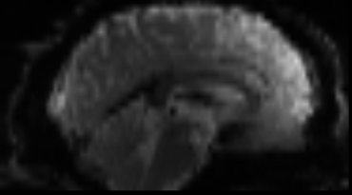
Data analysis Preprocessing
6 steps:
Slice time correction
Motion correction
Co-registration
Normalization
Spatial smoothing
Temporal filtering

Slide 14
Data analysis Preprocessing
6 steps:
Slice time correction
Motion correction
Co-registration
Normalization
Spatial smoothing
Temporal filtering
}
Ability to compare different individuals

Slide 15
Data analysis Preprocessing
6 steps:
Slice time correction
Motion correction
Co-registration
Normalization
Spatial smoothing
Temporal filtering
Structural data (~1mm)
Functional run (~3mm)

Slide 16
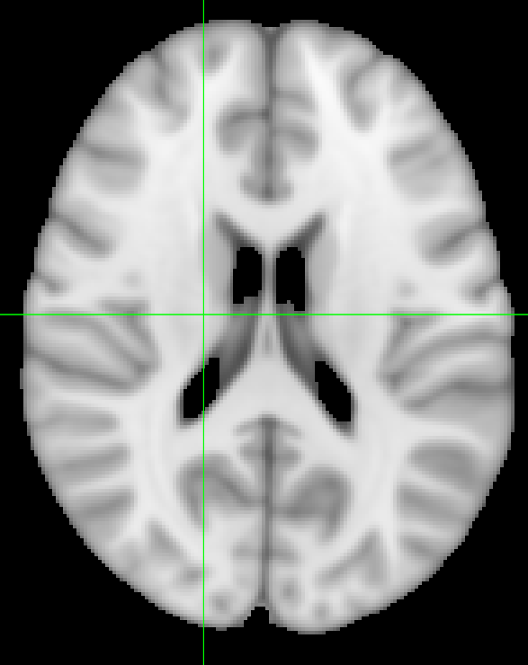
Data analysis Preprocessing
6 steps:
Slice time correction
Motion correction
Co-registration
Normalization
Spatial smoothing
Temporal filtering
Functional run (~3mm)
Structural data (~1mm)
MNI152 (.5/1/2mm)

Slide 17
Data analysis Preprocessing
6 steps:
Slice time correction
Motion correction
Co-registration
Normalization
Spatial smoothing
Temporal filtering
}
Increasing signal to noise ratio

Slide 18
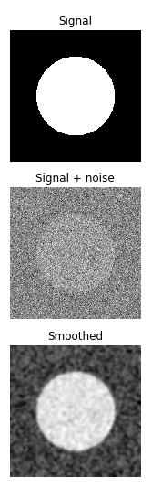
Data analysis Preprocessing
Signal is present over a spatial extent (e.g., a brain structure)
Noise is random
Smoothing cancels out noise, while signal remains
6 steps:
Slice time correction
Motion correction
Co-registration
Normalization
Spatial smoothing
Temporal filtering

Slide 19
Data analysis Preprocessing
6 steps:
Slice time correction
Motion correction
Co-registration
Normalization
Spatial smoothing
Temporal filtering

Slide 20
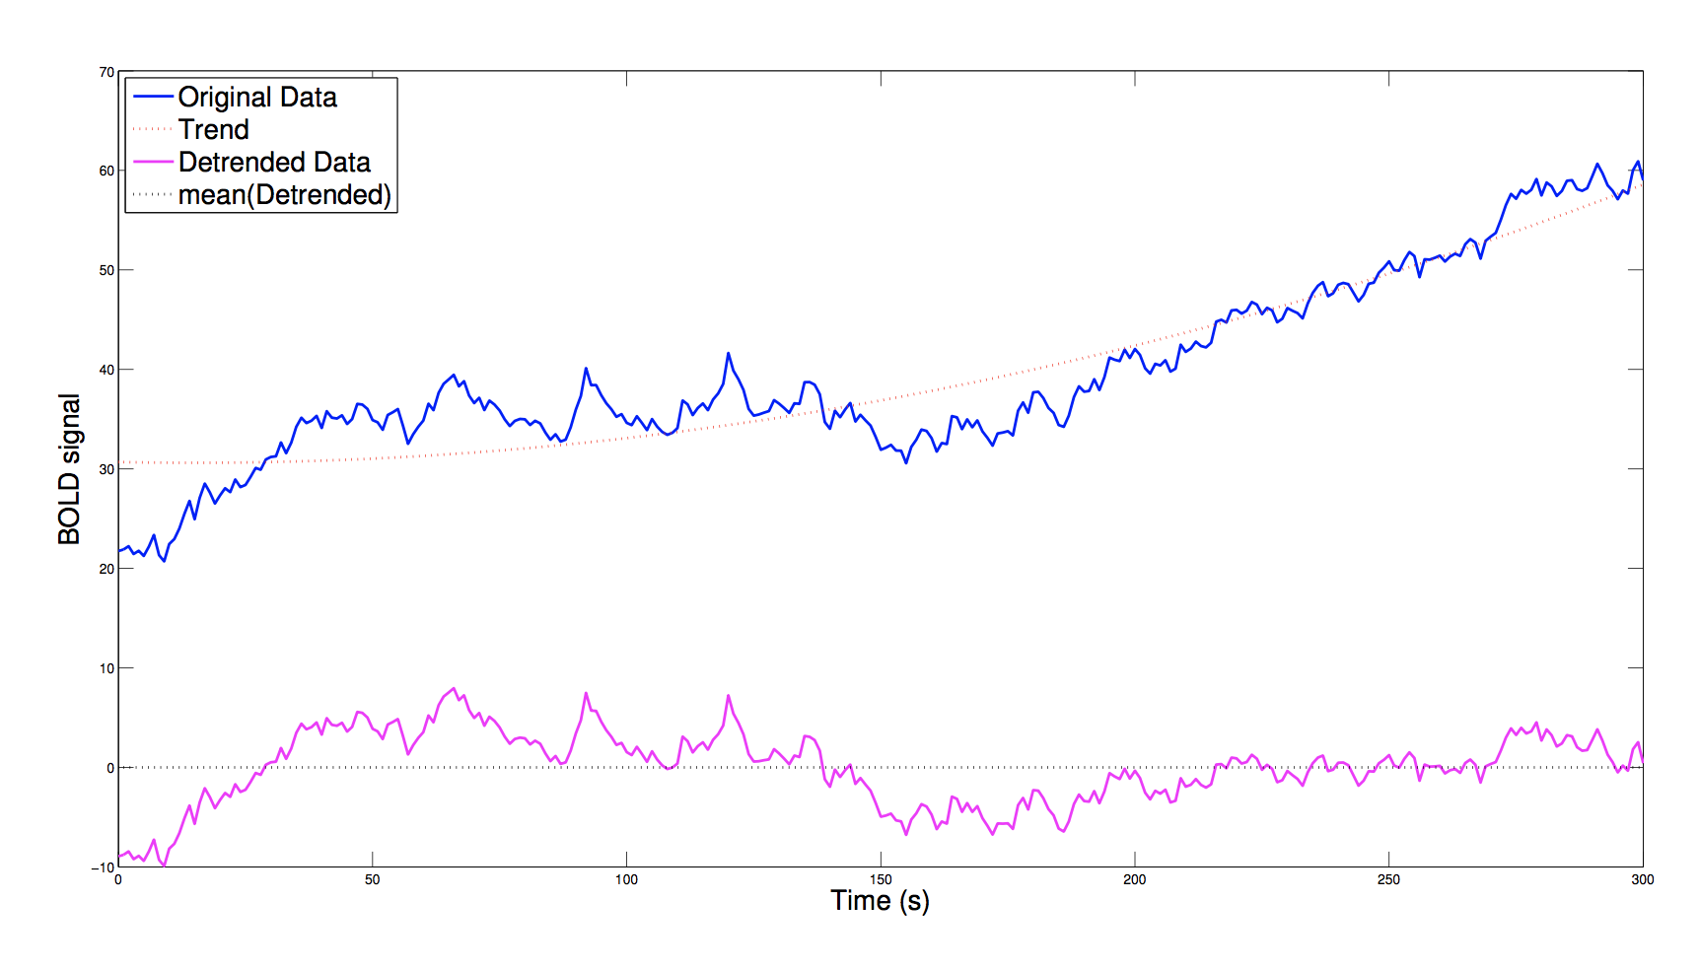
Data analysis Preprocessing
6 steps:
Slice time correction
Motion correction
Co-registration
Normalization
Spatial smoothing
Temporal filtering

Slide 21
Data analysis Preprocessing
6? steps:
Slice time correction
Motion correction
Co-registration
Normalization
Spatial smoothing
Temporal filtering
(distortion correction, other potential steps)
Carp (2013): 6912 unique pipelines (only SPM & AFNI)
(see also Botvinik-Nezer et al, 2020)
What to do?

Slide 22
Data analysis Preprocessing
Towards standardization of (f)MRI processing
fmriprep
“Out of the box” preprocessing pipeline, sets preprocessing settings based on type of data provided
Good place to start
http://fmriprep.readthedocs.io/

Slide 23
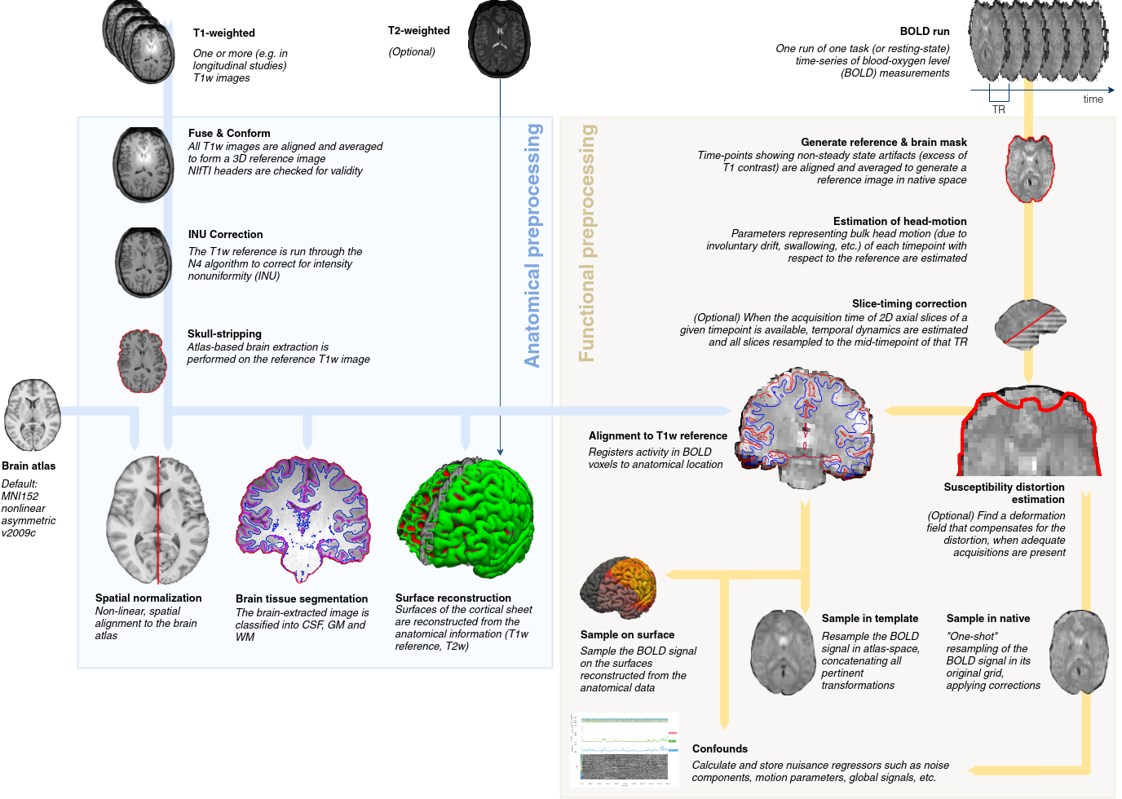
Data analysis Preprocessing
fmriprep

Slide 24
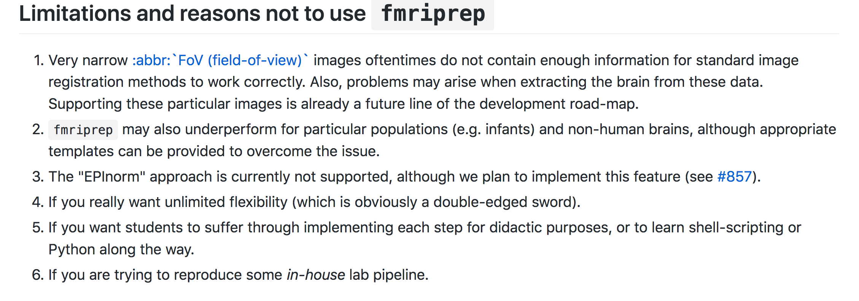
Data analysis Preprocessing
Do it yourself: Nipype (practical today)

Slide 25
Outline Lecture
Introduction to functional magnetic resonance imaging
What are we measuring?
How do we analyze the data?
Preprocessing
Traditional: Mass-univariate analyses
Model-based analyses
Python for neuroscience

Slide 26
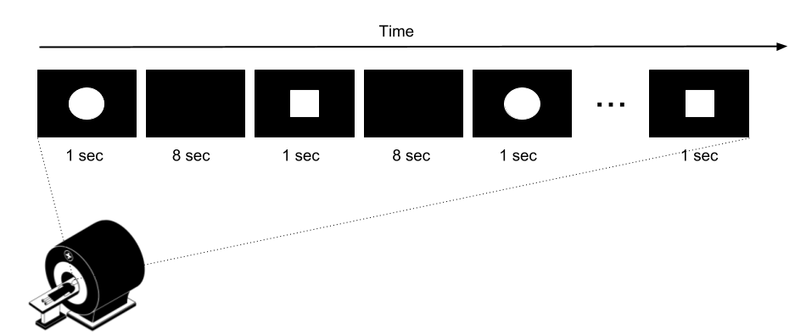
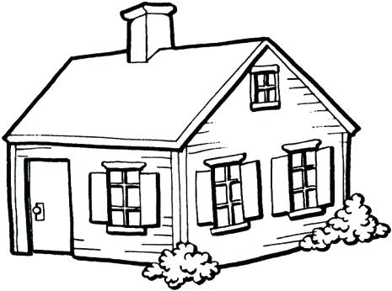
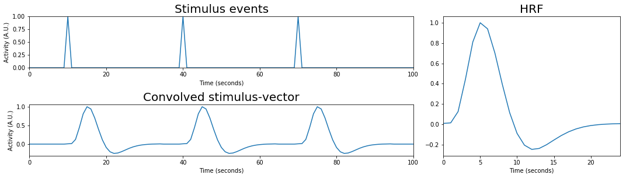
Data analysis Task-related analysis
Consider we do a very simple experiment…
“Which brain areas respond to the presentation of this picture?”
30 sec
30 sec
A picture of a house is shown at 10s, 40s, and 70s

Slide 27
Data analysis Task-related analysis
General idea of the GLM analysis:
“Given my task, what would the BOLD-signal look like?”
Generate hypothetical BOLD-signal

Slide 28
Data analysis Task-related analysis
1. Generate hypothetical BOLD-signal

Slide 29
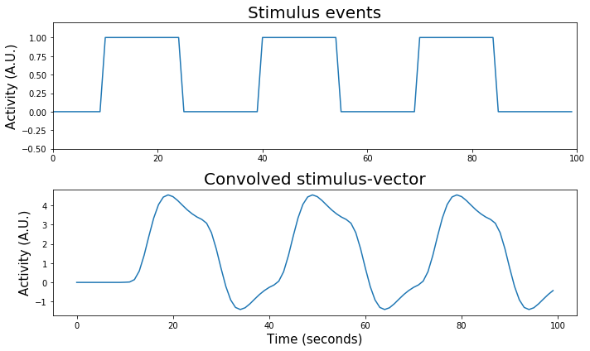
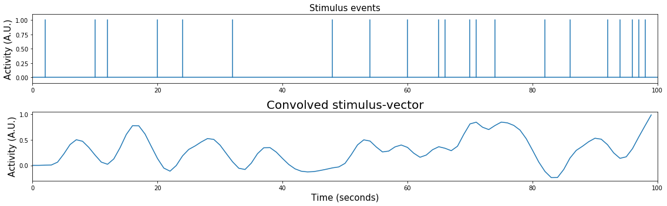
Data analysis Task-related analysis
Linear time invariance

Slide 30
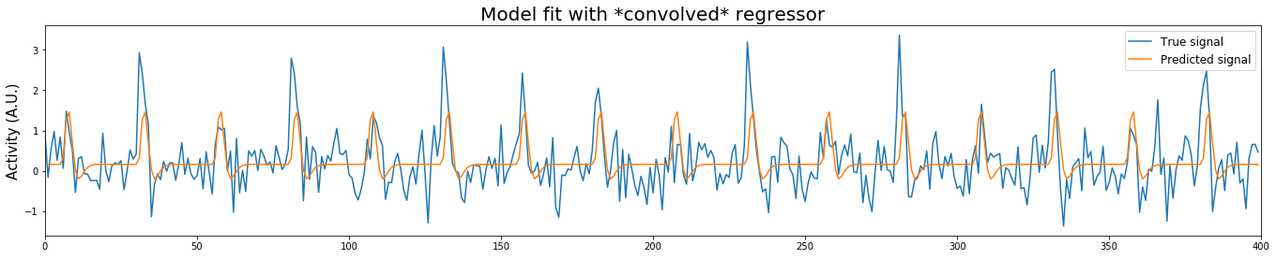
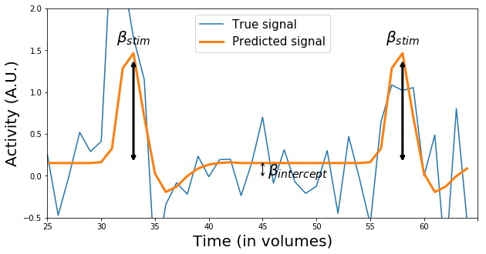

Data analysis Task-related analysis
“Given my task, what would the BOLD-signal look like?”
Generate hypothetical BOLD-signal, based on your experimental design
Regress this hypothetical BOLD-signal to data in each voxel
GLM:
$$Y= β_{int}+β_{stim}∗X+ ε$$

Slide 31
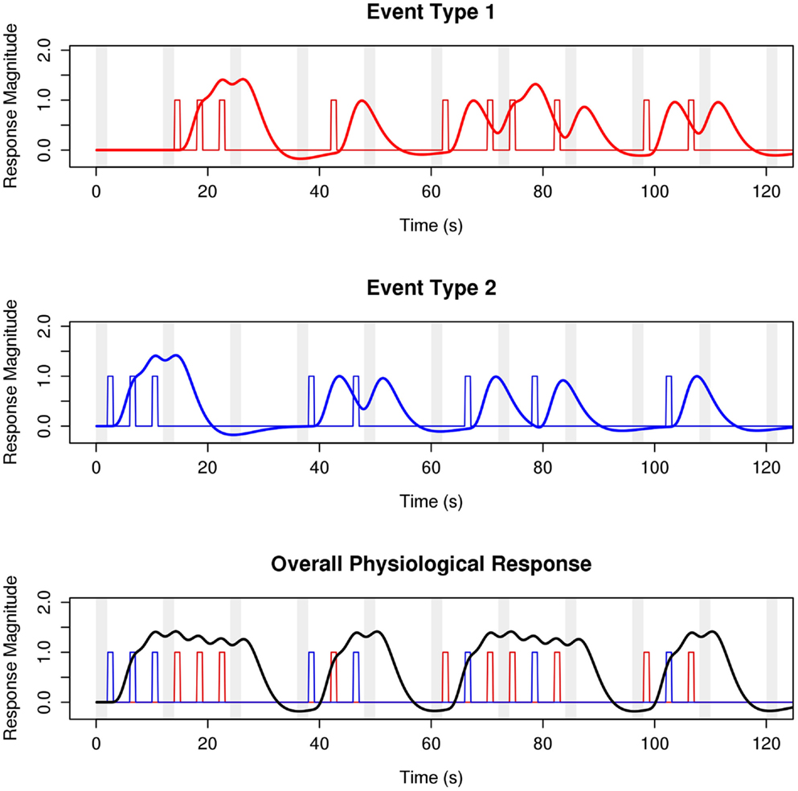

Data analysis Task-related analysis
Multiple event types
GLM:
$$Y= β_{int}+β_{stim1}∗X_{stim1}+β_{stim2}∗X_{stim2}+ ε$$

Slide 32
Data analysis Task-related analysis
The result of the GLM:
For each subject, a brain map of:
For every voxel:
A beta estimate for every regressor
Variance
(contrasts)

Slide 33
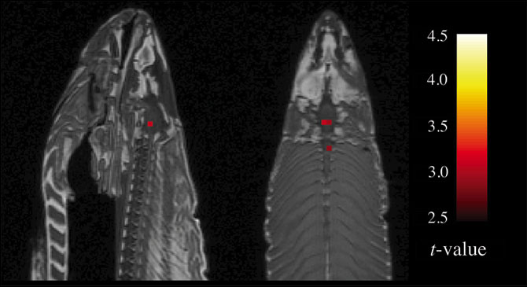
Beware of dead salmons
Bennett et al., 2009

Slide 34
Multiple comparisons
Typical number of voxels: 150.000
Typical number of tests: …150.000
Chance of finding at least 1 Type 1 error: (1-0.95^150.000)
=~ 1.
Options:
ROI-based analyses (reduce the number of tests)
Gaussian random field theory
False discovery rate

Slide 35
Outline Lecture
Introduction to functional magnetic resonance imaging
What are we measuring?
How do we analyze the data?
Preprocessing
Traditional: Mass-univariate analyses
Model-based analyses
Python for neuroscience

Slide 36
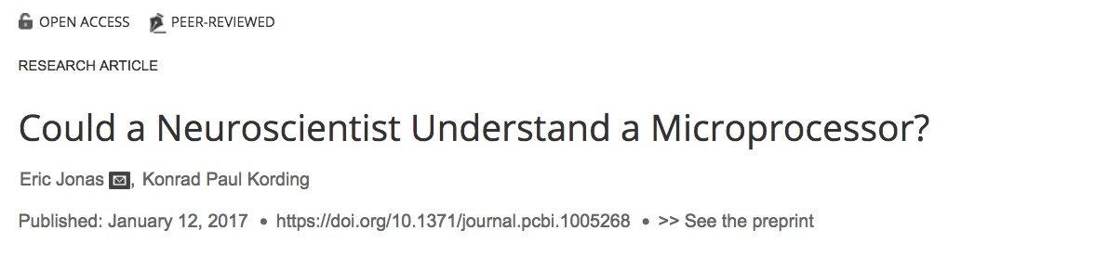
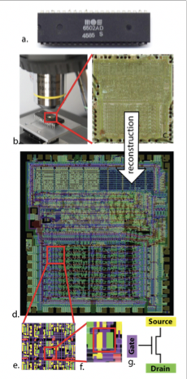
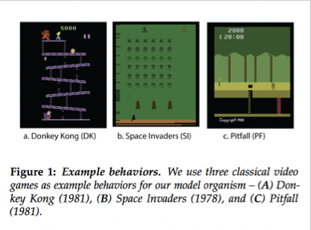
Model-based analyses
A little detour

Slide 37
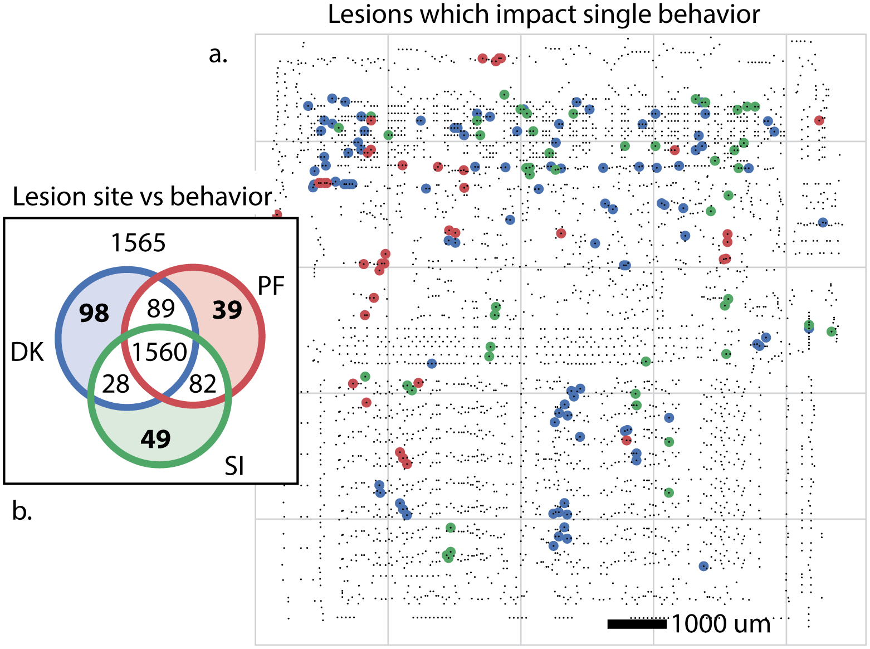
Model-based analyses
A little detour

Slide 38
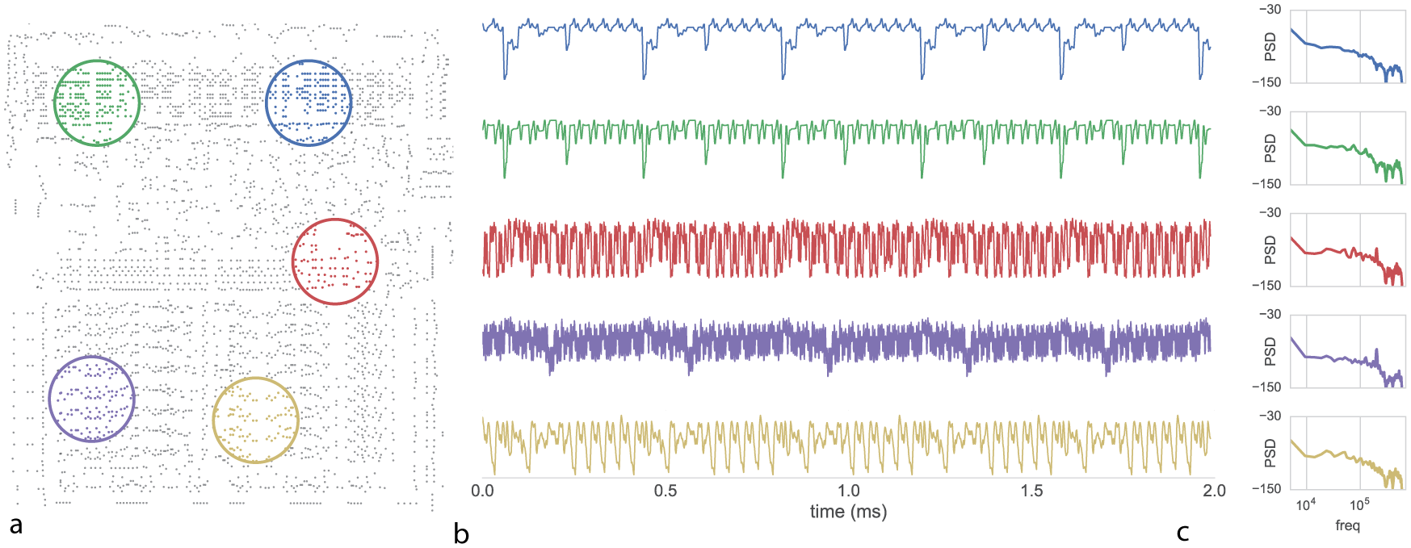
Model-based analyses
A little detour

Slide 39
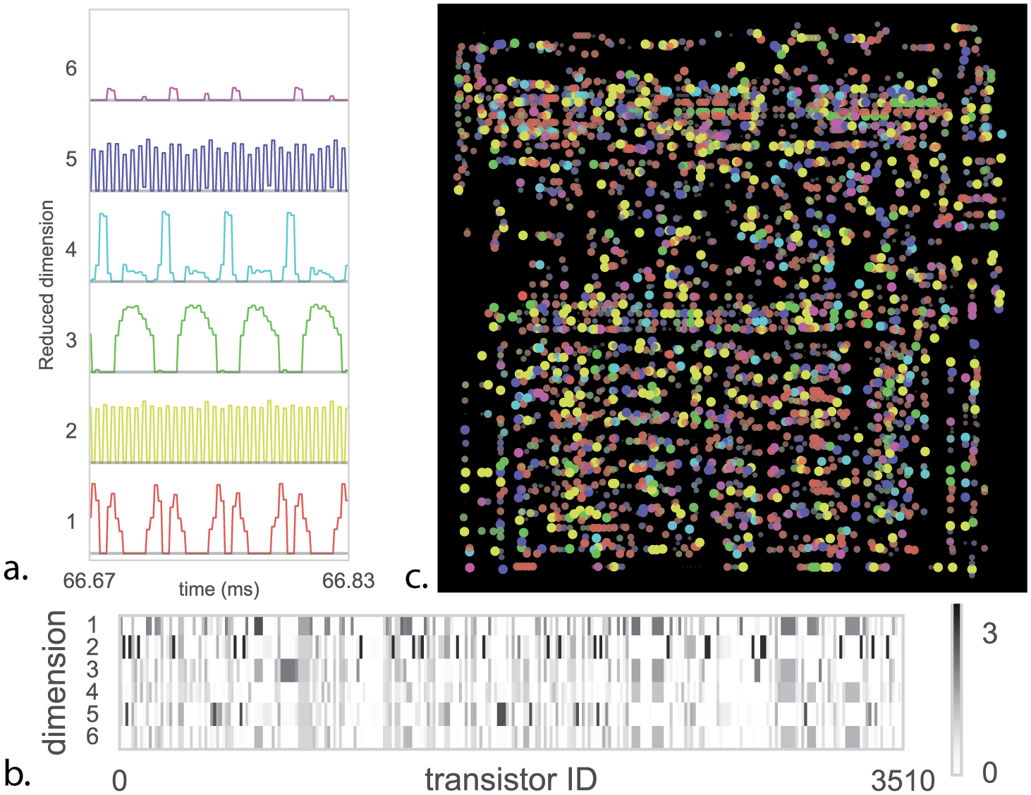
Model-based analyses
A little detour

Slide 40
Model-based analyses
“We find that many approaches in neuroscience, when used naïvely, fall short of producing a meaningful understanding.”

Slide 41
Model-based analyses
Behavior is not “booting” vs “not booting”
Experimental psychology for clever experimental design, decomposing behavior
Mathematical psychology for formally modelling behavioral processes
Model-based neuroscience

Slide 42
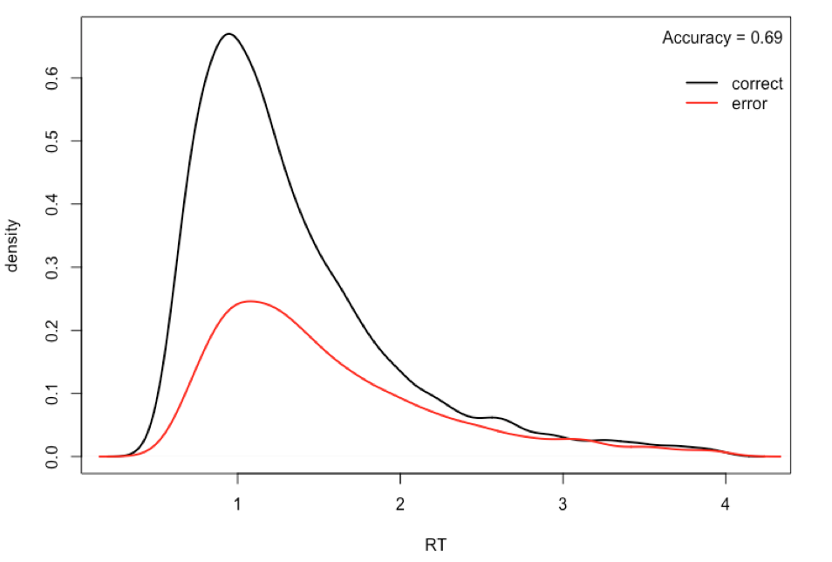
Model-based analyses Approaches

Slide 43
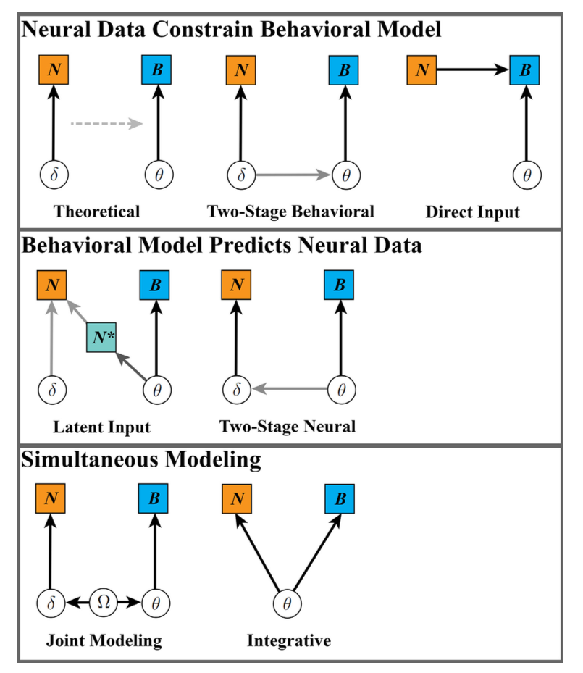
Model-based analyses Approaches
Turner et al. (2017)

Slide 44

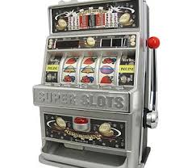

Model-based analyses Latent input
Behavioral model provides latent states hypothesized to underlie activity
$$V_{t+1}=V_{t}+αδ_{t}$$
$$δ_{t}={R_{t}−V}_{t}$$

Slide 45
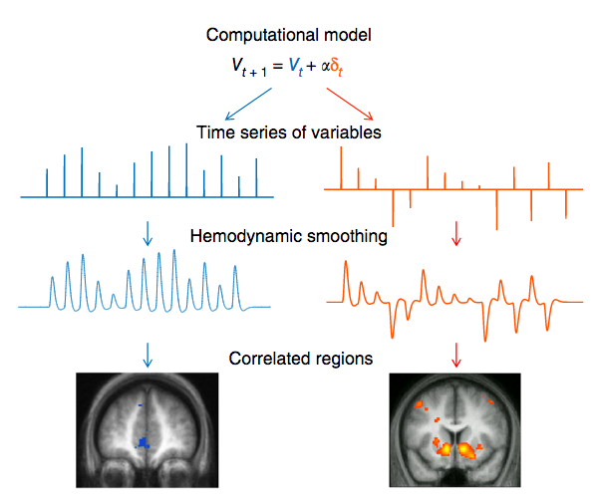
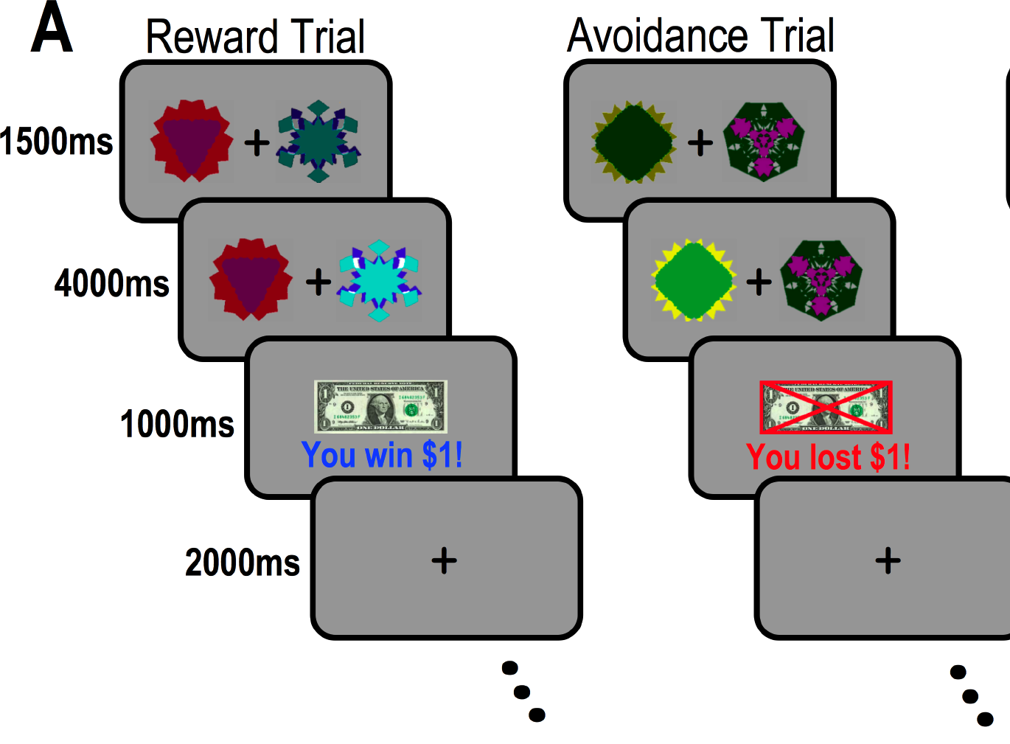

Model-based analyses Latent input
$$V_{t+1}=V_{t}+αδ_{t}$$
$$δ_{t}={R_{t}−V}_{t}$$
Kim et al (2006)
Cohen et al (2017)

Slide 46
Model-based analyses Approaches
Turner et al. (2017)

Slide 47
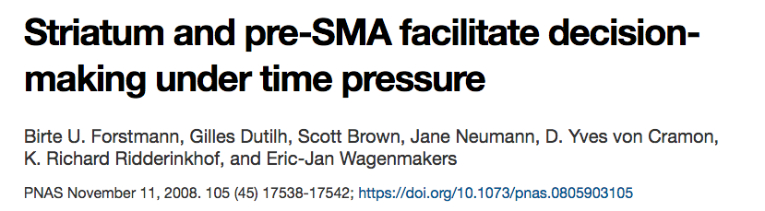
Model-based analyses Two-stage neural

Slide 48
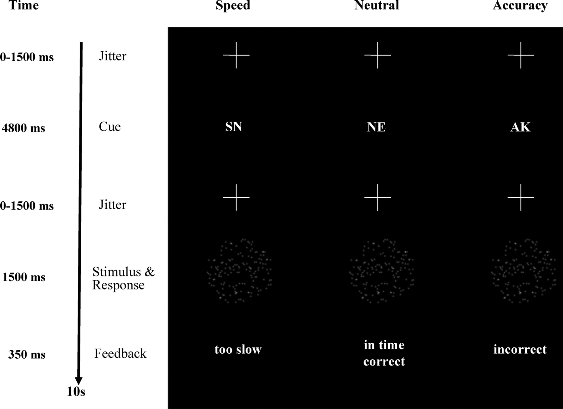
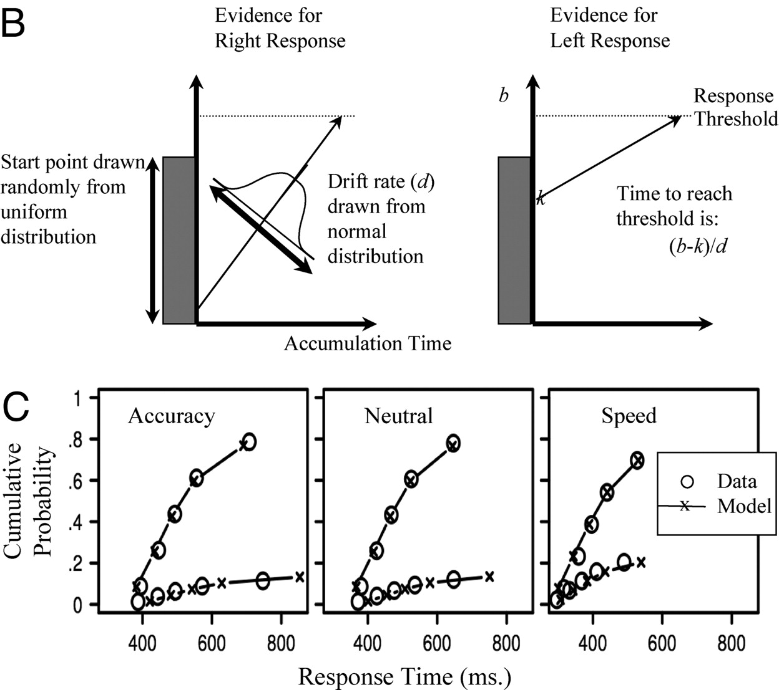
Model-based analyses Two-stage neural

Slide 49
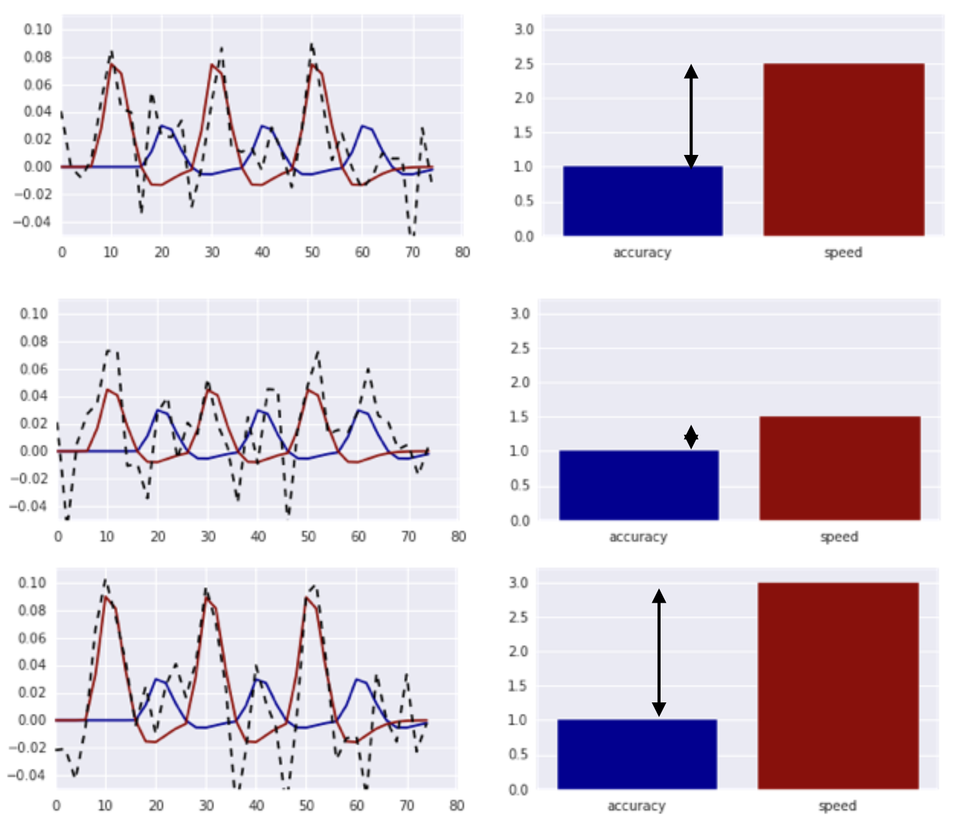
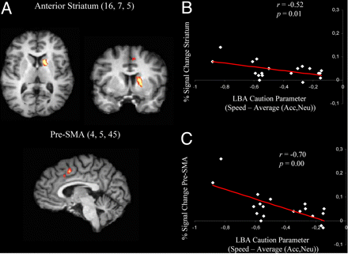
Model-based analyses Two-stage neural

Slide 50
Model-based analyses Two-stage neural
Individual difference approach:
Correlation between striatum activity and cognitive model parameter estimates

Slide 51
Model-based analyses Approaches
Turner et al. (2017)

Slide 52
Model-based analyses
Introduction to functional magnetic resonance imaging
What are we measuring?
How do we analyze the data?
Preprocessing
Traditional: Mass-univariate analyses
Model-based analyses
Python for neuroscience

Slide 53
Python for neuroscience
As a model-based cognitive neuroscientist, you need to work with:
1. Statistical models of behavior
2. Statistical models of neural data
3. Cognitive models of behavior
SPSS doesn’t do (all of) this, so you’ll be coding a lot

Slide 54

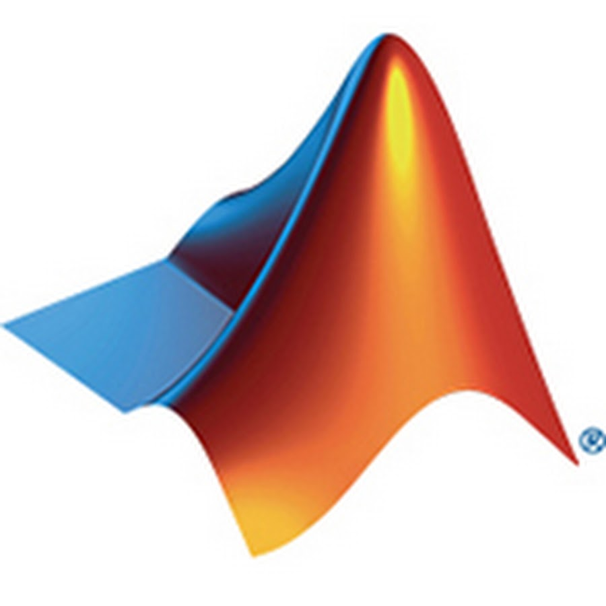

Python for neuroscience Language options

Slide 55
Python for neuroscience Why Python?
Very good from a software perspective
Object-oriented
Easy to read and code
Momentum in neuroscience
Many useful scientific libraries available
Open-source, free (no tax money going to software companies)
(Developed in Amsterdam)
Development Community

Slide 56



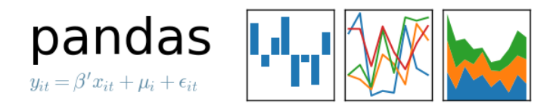
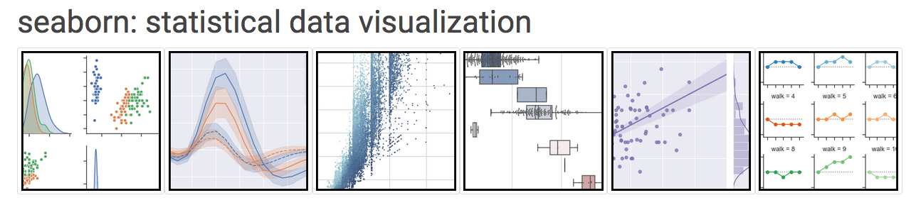



Python for neuroscience Why Python?
Very good from a software perspective
Object-oriented
Easy to read and code
Momentum in neuroscience
Many useful scientific libraries available
Open-source, free (no tax money going to software companies)
(Developed in Amsterdam)
Development Community

Slide 57
Python for neuroscience Today’s tutorial
4 notebooks:
Pre-processing fMRI data
Modelling behavioral data (actually R)
Extracting signal from a ROI
Model-based analysis

